Slide 1
OAuth 2.0 and the Google API Client for Python

Slide 2
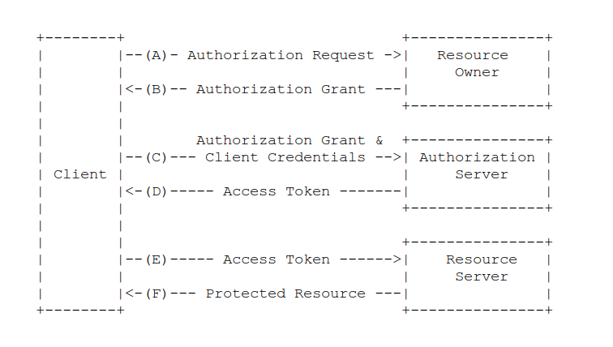
What is OAuth 2.0?
OAuth 2.0 the protocol can be a little complex.

Slide 3

What is OAuth 2.0?
API
User
App
It is trying to solve a tricky problem.

Slide 4
What is OAuth 2.0?
API
User
App
If you, the developer, are building an application.

Slide 5
What is OAuth 2.0?
API
User
App
And your users

Slide 6
What is OAuth 2.0?
API
User
App
have data in another service that your application needs to function

Slide 7
What is OAuth 2.0?
API
User
App
such as their tasks list, or their photos

Slide 8
What is OAuth 2.0?
???
API
User
App
how do you go about getting it?

Slide 9
Noooooooo
API
User
name, password
name, password
App
You could ask the user for their name and password.

Slide 10
Noooooooo
API
User
X
name, password
name, password
X
App
But then the user has given your application access to all their data on that service. That's not safe. Don't do that.

Slide 11
Noooooooo
API
User
X
name, password
name, password
X
App
The user's name and password are like keys to their digital kingdom, you should never ask for them.

Slide 12
Better
API
User
App
What we really want is a special key, one that only allows access to a limited set of data in the API.

Slide 13
Better
API
User
App
A special key that the User can let the App acquire and use without the use of their name and password.

Slide 14
This is OAuth 2.0
API
User
App
But for that to work, everyone has to confirm that everyone else is who they say they are.

Slide 15
This is OAuth 2.0
Which is where the complexity comes from.

Slide 16
Keys
API
User
App
It's actually a little more complicated than even that, because that special key

Slide 17
Keys
API
User
App
can change over time to keep things secure.

Slide 18
Keys
API
User
App
Now that we know what OAuth 2.0 looks like, how does it work in the Google API Client for Python?

Slide 19
Credentials
API
User
Credentials
App
The key is held in a Credentials object.

Slide 20
Flow
API
User
Flow
App
All the steps needed to go through getting Credentials is in a Flow object.

Slide 21
Storage
Storage
And finally, because keys can change over time there is a Storage object for storing and retrieving keys.

Slide 22
The model
Flow
Credentials
Storage
You set up and run a Flow, which in the end produces Credentials, which you store in a Storage.

Slide 23
From Python
API
User
App
Later, when you need the key, you take it out of Storage and use it.

Slide 24
This is OAuth 2.0
Which I hope you agree is simpler than this.

Slide 25
Step by step
So let's look at actual code.

Slide 26
Step by step
FLOW = OAuth2WebServerFlow(
client_id='<CLIENT ID HERE>',
client_secret='<CLIENT SECRET HERE>',
redirect_uri='https://.../oauth2callback',
scope='https://.../tasks',
user_agent='my-sample/1.0')
First, create a Flow.

Slide 27
Step by step
FLOW = OAuth2WebServerFlow(
client_id='<CLIENT ID HERE>',
client_secret='<CLIENT SECRET HERE>',
redirect_uri='https://.../oauth2callback',
scope='https://.../tasks',
user_agent='my-sample/1.0')
For Google APIs you visit http://code.google.com/apis/console to create a client id and secret for your application.

Slide 28
Step by step
authorize_url = FLOW.step1_get_authorize_url()
self.redirect(authorize_url)
Then we kick off the Flow.

Slide 29
Step by step
credentials = flow.step2_exchange(self.request.params)
storage = StorageByKeyName(
Credentials, user.user_id(), 'credentials'
)
storage.put(credentials)
We get Credentials when the Flow finishes, which we save in a Storage.

Slide 30
Step by step
user = users.get_current_user()
storage = StorageByKeyName(
Credentials, user.user_id(), 'credentials'
)
credentials = storage.get()
http = httplib2.Http()
http = credentials.authorize(http)
To use Credentials we retrieve them from the Storage and apply them to an httplib2.Http() object.

Slide 31
Step by step
user = users.get_current_user()
storage = StorageByKeyName(
Credentials, user.user_id(), 'credentials'
)
credentials = storage.get()
http = httplib2.Http()
http = credentials.authorize(http)
Now any HTTP requests made with http will be authorized with those Credentials.

Slide 32
Specializations
Storage
oauth2client.appengine.StorageByKeyName
oauth2client.django_orm.Storage
oauth2client.file.Storage
There are Storage classes for different platforms

Slide 33
Details
decorator = OAuth2Decorator(
client_id='<YOUR CLIENT ID>',
client_secret='<YOUR CLIENT SECRET>',
scope='htt.../tasks',
user_agent='my-sample-app/1.0')
http = httplib2.Http(memcache)
service = discovery.build('tasks', 'v1', http=http)
class MainHandler(webapp.RequestHandler):
@decorator.oauth_required
def get(self):
http = decorator.http()
followers = service.people().list(
And there are helpers for App Engine that make things even easier.

Slide 34
Details
decorator = OAuth2Decorator(
client_id='<YOUR CLIENT ID>',
client_secret='<YOUR CLIENT SECRET>',
scope='htt.../tasks',
user_agent='my-sample-app/1.0')
http = httplib2.Http(memcache)
service = discovery.build('tasks', 'v1', http=http)
class MainHandler(webapp.RequestHandler):
@decorator.oauth_required
def get(self):
http = decorator.http()
followers = service.people().list(
The decorator uses Flows, Storage and Credentials, but does so under the covers.

Slide 35
Details
decorator = OAuth2Decorator(
client_id='<YOUR CLIENT ID>',
client_secret='<YOUR CLIENT SECRET>',
scope='htt.../tasks',
user_agent='my-sample-app/1.0')
http = httplib2.Http(memcache)
service = discovery.build('tasks', 'v1', http=http)
class MainHandler(webapp.RequestHandler):
@decorator.oauth_aware
def get(self):
if decorator.has_credentials():
http = decorator.http()
followers = service.people().list(
While oauth_required is the simplest interface to use, the suggested interface is oauth_aware.

Slide 36
Details
decorator = OAuth2Decorator(
client_id='<YOUR CLIENT ID>',
client_secret='<YOUR CLIENT SECRET>',
scope='htt.../tasks',
user_agent='my-sample-app/1.0')
http = httplib2.Http(memcache)
service = discovery.build('tasks', 'v1', http=http)
class MainHandler(webapp.RequestHandler):
@decorator.oauth_aware
def get(self):
if decorator.has_credentials():
http = decorator.http()
followers = service.people().list(
...
else:
link = decorator.authorize_url()
...
So you can put a link for the user to follow along next to an explanation of why you are requesting access to their data.

Slide 37
The End
That's it for this overview. Here's some further reading.
There's more info on the wiki:
https://developers.google.com/api-client-library/python/guide/aaa_oauth
And PyDoc for all the classes we've talked about:
OAuth2WebServerFlow
Credentials
StorageByKeyName
OAuth2Decorator

